Slide 1

Employee Data Analysis using Excel
STUDENT NAME: Tamilarasi. P
REGISTER NO:
312204748/FCF05C5AFA602B9A3EF4C039BF45A23A
DEPARTMENT: Commerce
COLLEGE: New Prince Shri Bhavani Arts and Science College

Slide 2
PROJECT TITLE :
Employee Performance Analysis using

Slide 3



AGENDA
ProbIem Statement
Project Overview
End Users
Our Solution and Proposition
Dataset Description 6.ModeIIing Approach
7.Results and Discussion 8.Conclusion

Slide 4


PROBLEM STATEMENT
Performance analysis are made to a employees. Increment to check the performance track of the employees and it is useful for the employees personal as well as organizational growth.
So, the employees performance analysis helps te•'
require all the problems and have a
successful organisation.

Slide 5


PROJECT OVERVIEW
Analysing the performance of the employees byconsidering the various factors like ;
Gender
Performance score
Rating
Their involvement in work and various scores that analysisthe performance of employees in the organization.

Slide 6





WHO ARE THE END USERS?
Employees
Employer
Manager

Slide 7



OUR SOLUTION AND ITS VALUE PROPOSITION
Target audience. Whose problems will be solved by your product or service.
Benifits and features. How are they
different from your competitors.
Products or service. What is your brand
promise?
Excellent execution. Can you deliver on your value proposition?

Slide 8

ataset Description
Employee d ata set- Kaggle
There are 26 features
The important ten features are,
Employment ID
*First name
*Last name
*Gender
*Employee status
*Employee type
*Employee classification
*Performance score
*Current employee ratings
Business units

Slide 9



TH ”WOW” I
OUR SOLUTIO
Performance Level— There are categories into Levels such as very high,high,med,Iow,etc...
Using Pivot table and charts is to analyse the employees performance.

Slide 10


ODELLING:
*Data Preparation Clean and organize data, ensuring accuracy and consistency
*Trend Analysis Apply charts and graphs (e g , line charts, bar graphs) to visualize trends over time, sucn as employee performance or turnover rates
*Pivot Tables Create pivot taDles to aggregate and analyze
data across different dimensions, such as department, tenure.
ole
*Regression Analysis Utilize regression functions to identify relationsnips between variables, sucn as the impact of training on performance

Slide 11
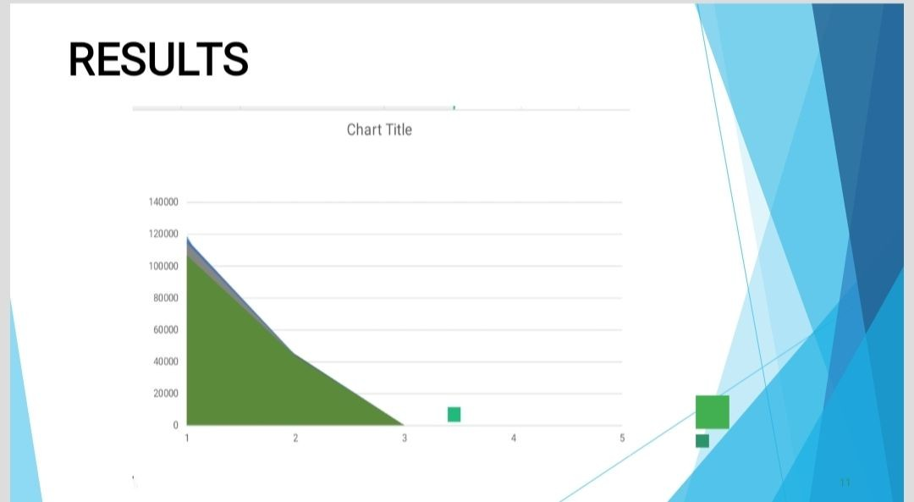

Slide 12


usion
The conclusion of employee data analysis reveals key insights into workforce trends, performance, and areas for improvement. By analyzing metrics such as productivity, turnover rates, and engagement level s, organizations can identify strengths and weaknesses in their HR strategies. This analysis supports data driven decision-making, enabling targeted interventions to enhance employee performance, optimize recruitment processes, and improve overall organizational effectiveness. In essence, effective data analysis provides a foundation for strategic planning and operational improvements, leading to a more motivated and productive workforce.

